Slide 1
MACS 30100
Comparing Lexical (TF-IDF) and Semantic Representations in Sentence-Level Sentiment Classification
Victoria Wen
Video Link:
https://drive.google.com/file/d/1GFaC-cjp0WDPthYG6yaWwY5rSVEYHYx7/view?usp=sharing

Slide 2
Background and Motivations
Ramdan, D. S., & Apnena, R. D. (2023)
TF-IDF features combined with logistic regression can successfully classify movie reviews into positive and negative sentiment.
Devlin, J., Chang, M.-W., Lee, K., & Toutanova, K. (2019)
Pretrained contextual embeddings capture rich semantic and affective information that can be used for tasks such as sentiment classification.
Reimers, N., & Gurevych, I. (2019)
Introduces Sentence-BERT, showing that sentence-level embeddings are effective for semantic similarity and clustering tasks, supporting the representation framework used in this project.
In this Study:
1. Direct comparison of TF-IDF (lexical) and Embedding (semantic) logistic regression
2. Unsupervised Learning- Clustering

Slide 3
Research Questions and Hypotheses
RQ: Do semantic embeddings capture human sentiment judgments better than lexical features? Do sentiments emerge in unsupervised clusters?
Hypothesis: Embeddings are more effective for human sentiment judgments than lexical features, and sentiments will emerge in unsupervised clusters.

Slide 4
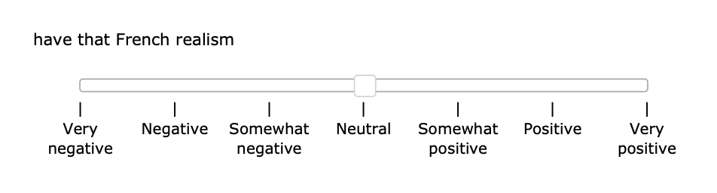
Data Source
Stanford Sentiment Treebank (SST)
Contains sentence-level movie reviews annotated for sentiment, widely used for evaluating sentiment classification models.
Data size: 215,154 phrases extracted from the parse trees of 11,855 sentences.
Amazon Mechanical Turk to annotate all 215,154 unique phrases obtained from the parse trees

Slide 5
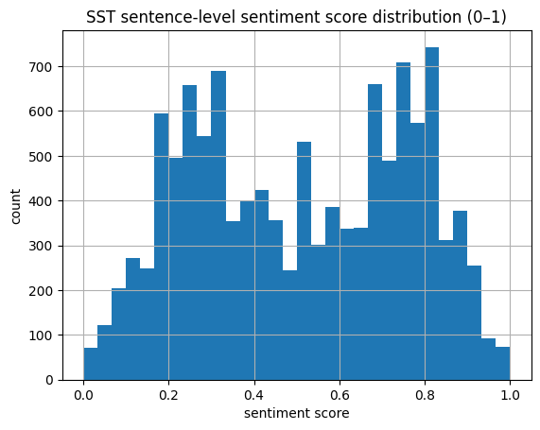
EDA
Total sentences: 11855
split: train 8544; test 2210; dev 1101
SOStr Fallback
map sentence → sentiment score
some raw sentence stings may not match the tokenized phrase in the dictionary file.
Sentence-level sentiment mapping coverage: 1.0000

Slide 6
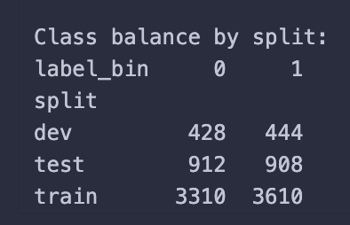
EDA - Build the Dataset
Binary split
Sentences with sentiment scores ≤ 0.4 were labeled as negative and those ≥ 0.6 were labeled as positive.
Sentences with scores between 0.4 and 0.6 were treated as neutral or ambiguous and removed from the dataset.
Positive: 4962; Negative: 4650

Slide 7
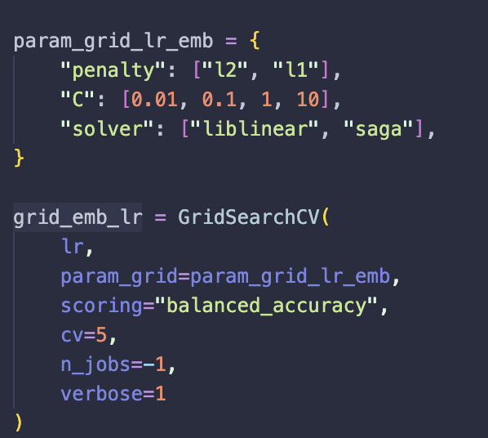

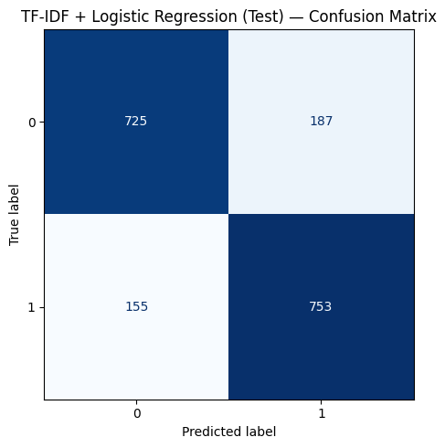
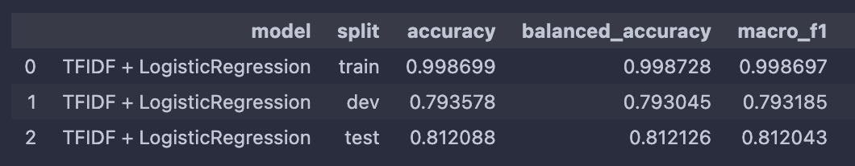
TFIDF + Logistic Regression
GridSearchCV: L2 penalty, C = 1
Accuracy: 0.789

Slide 8
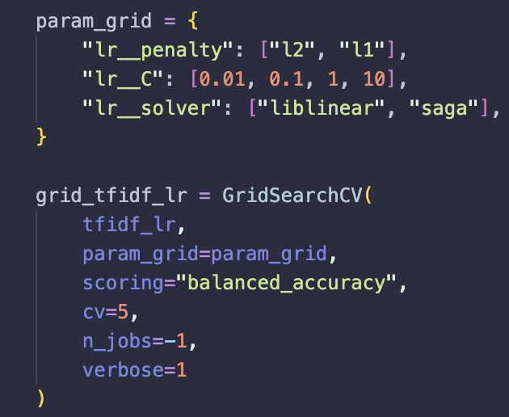
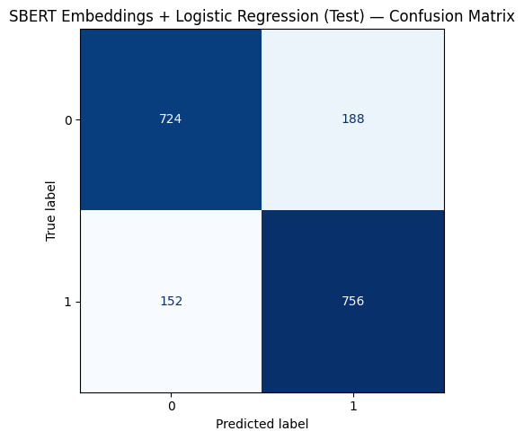
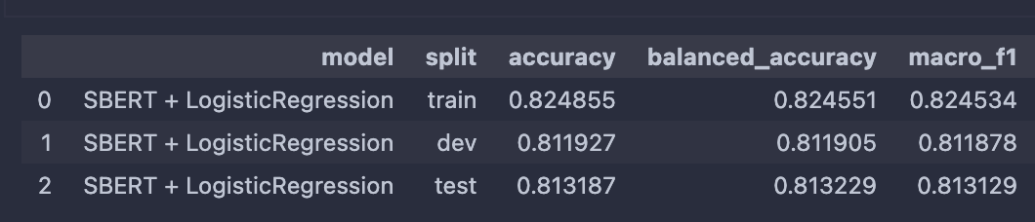
Embeddings + Logistic Regression
GridSearchCV: L1 penalty, C = 10
Accuracy: 0.804

Slide 9
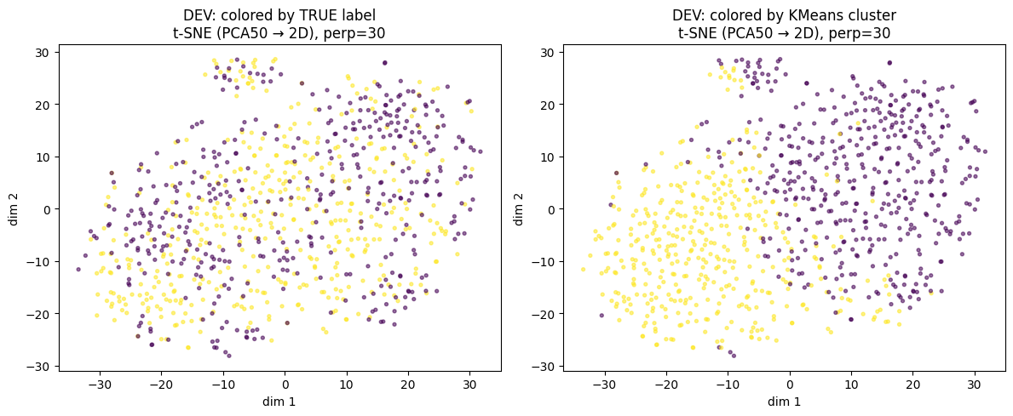
Unsupervised Task: K-means on Embeddings
# of clusters = 2
The true sentiment labels (positive vs negative) are heavily mixed across the space.
K-mean cluster: a clear separation
There is a meaningful structure in the embedding, but it’s not sentiment

Slide 10
Error Analysis - TF-IDF
Relies strongly on explicit lexical polarity
False positives (negative misclassified as positive):
Positive words dominate overall meaning
e.g., However it may please those who love movies that blare with pop songs , young science fiction fans will stomp away in disgust (prob_pos: 0.978)
False negatives (positive misclassified as negative):
Misses implicit or indirect positive sentiment
e.g., A taut psychological thriller that doesn't waste a moment of its two-hour running time.

Slide 11
Error Analysis - Embeddings
Uses broader semantic context
False positives (negative misclassified as positive):
Mixed praise + criticism interpreted as positive
E.g., Although Huppert 's intensity and focus has a raw exhilaration about it , The Piano Teacher is anything but fun .
Descriptive language may appear sentimentally positive
E.g., It showcases Carvey 's talent for voices , but not nearly enough and not without taxing every drop of one 's patience to get to the good stuff .
False negatives (positive misclassified as negative):
Short or implicit sentiment is difficult
Idiomatic phrasing and negation still cause errors

Slide 12
Possible Improvements
Current TF-IDF mainly uses surface word frequency
add higher-order n-grams (e.g., trigrams)
preserve important negation patterns
Fine-tune embeddings jointly with classifier (Right now logistic regression learns after embeddings are fixed)
fine-tune the encoder together with classification objective
Improves: subtle sentiment, negation, idioms

Slide 13
Overall Comparison
TF-IDF model
Has slightly lower accuracy (~78%)
Works well when sentiment is expressed through clear lexical markers
Cannot capture sentence structure
Embedding model
Has a slightly higher accuracy (~ 80.3%);
Better captures overall semantic meaning
Can misinterpret subtle or ambiguous sentiment
Clustering
sentiment structure does not strongly emerge in the embedding space without supervision
sentiment may not be organized as a simple geometric cluster structure, and may be encoded in more complex directions or dimensions of the representation space.

Slide 14
Thank you!
Victoria Wen

